Slide 1
Team CAAT Final Update
Add-on for AnisoMPM
Chase Austin, Alex Finch, Addison Dugal, Thomas Wise

Slide 2
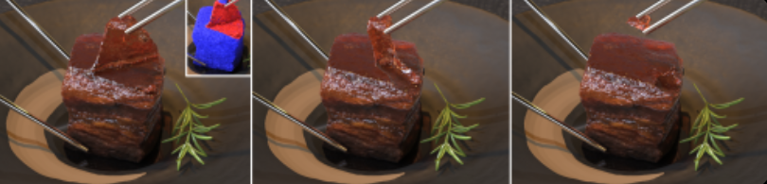
Our Objective
Create an open-source add-on for Blender to simulate damage to anisotropic materials using the algorithms in AnisoMPM, a project by a team SIGGRAPH at the University of Pennsylvania
User’s object in blender -> export to run damage algorithm -> return damaged object/frames of damage animation
Notes:
Addison

Slide 3

Damage Animation

Slide 4
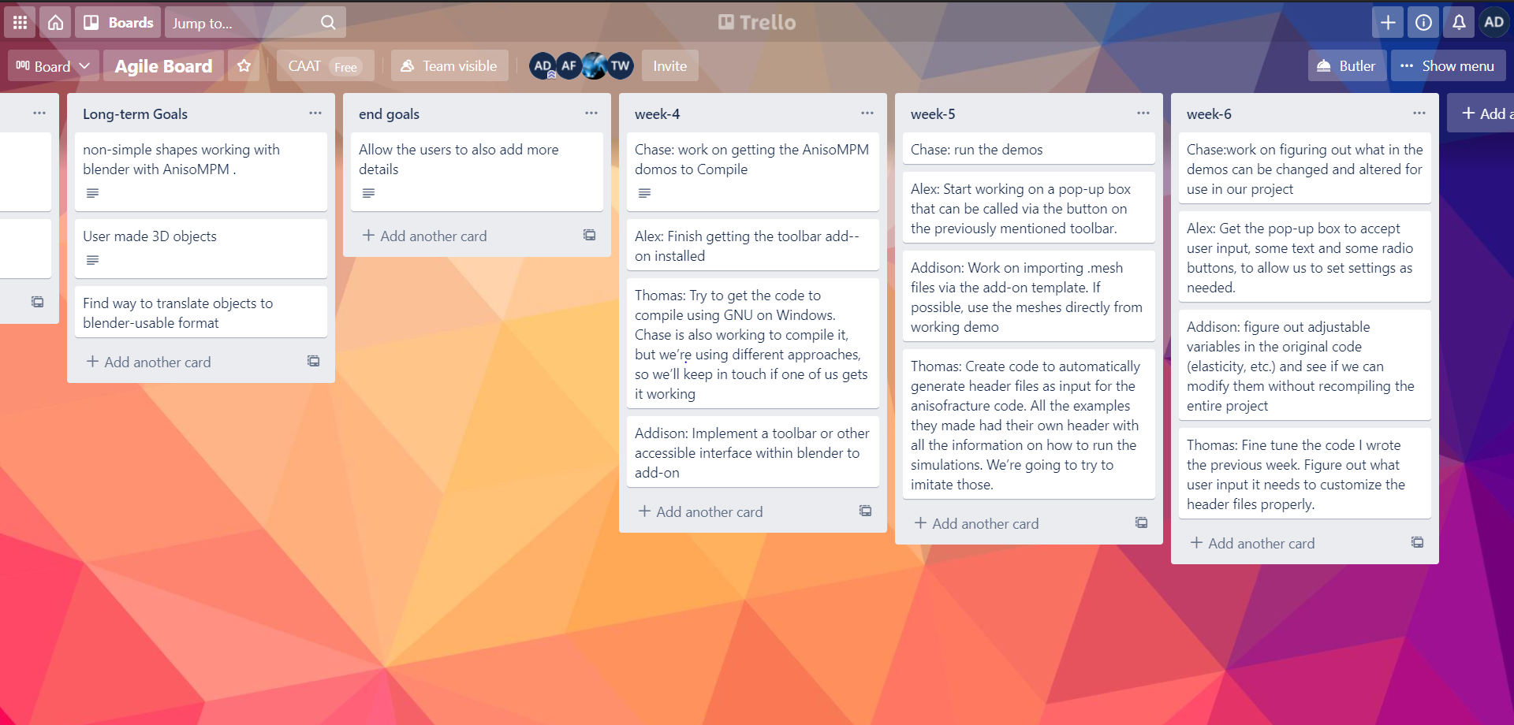
Organization
Weekly meetings and occasional code-running sessions via Discord
Agile Board via Trello
Notes:
Addison

Slide 5
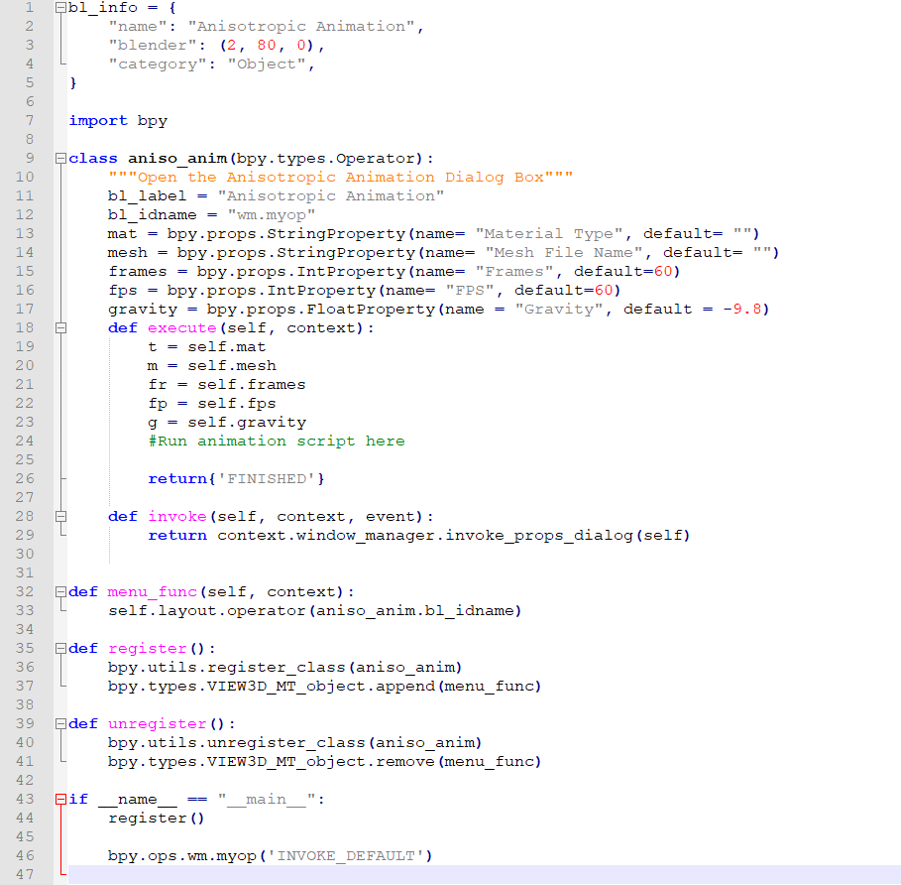
Blender add-ons
Add-ons are written primarily in Python
bpy must be imported (short for “Blender Python”)
Register/Unregister functions refer to what’s done when add-on is added/removed
Blender creates dialog boxes around classes
menu_func allows us to add the prompt to a menu within Blender.
Triple double-quotes creates mouse-over text
Notes:
Alex

Slide 6
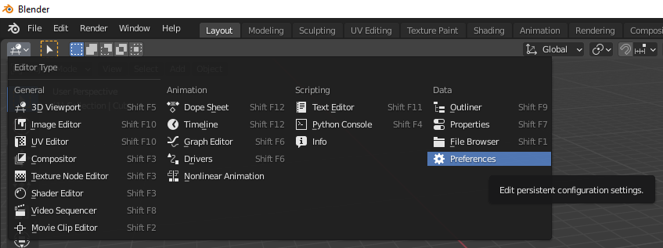
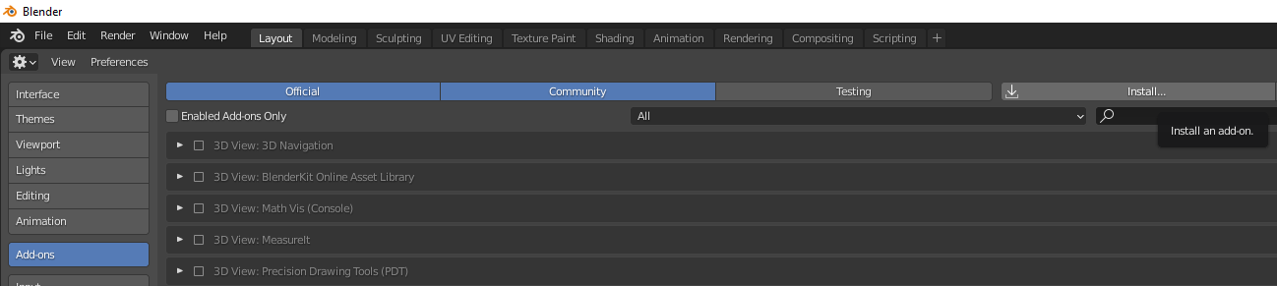
Adding Blender add-ons
Blender was designed around being modded.
Easy to install add-ons from the options menu
Notes:
Alex

Slide 7
Future of the add-on
Where the comment is, the a script should be written that runs the animation tools on the selected object.
The variables t, m, fr, fp, and g will set the basic parameters for the animation tools
More parameters would be added as more material types get coded.
Notes:
Alex

Slide 8
Run AnisoMPM
Needs
GNU 9.3.0 (GNU 7.5.0) Ubuntu works 18.04 or higher
Can use Windows 10 (cmake: line 29)
Need a GNU command line.
Dependencies
make cmake g++ libeigen3-dev gfortran libmetis-dev
libopenvdb-dev libboost-all-dev libilmbase-dev libopenexr-dev
libtbb2 libtbb-dev libz-dev clang-format-6.0 clang-format
Troubleshooting Compiling
Download mesh data
Building
cmake .. -DCMAKE_BUILD_TYPE=Release -DCMAKE_C_COMPILER=/usr/bin/gcc-7 -DCMAKE_CXX_COMPILER=/usr/bin/g++-7
“Check folder Projects/anisofracture for AnisoMPM” and run
Notes:
Cmakelists on line 29: option(ENABLE_AMGCL_CUDA "Use amgcl cuda" OFF)

Slide 9
AnisoMPM using TetWild
TetWild: another SIGGRAPH project based on importing/exporting/converting tetrahedral .mesh files
Same difficulties with using CMake as the AnisoMPM project
.mesh files are what AnisoMPM uses for Damage Mechanics
Tetrahedral: 3D mesh made by adding Tetrahedrons/Pyramids
Notes:
Made of pyramids

Slide 10
Adding objects to AnisoMPM
AnisoMPM uses header files to specify several things in the simulation about to be run.
.mesh file of the object we want to tear
Framerate
Number of Frames
Gravity
Info about the type of material (Density, Elasticity, etc.)
Info about how it is torn/cut/twisted/etc.
We created python scripts to generate these headers. One script for each type of material.

Slide 11
.bgeo files
Initial documentation showed that SIGGRAPH’s project would output a .mesh file, which we were researching to convert to .obj, the standard file format for Blender and Unity using tools such as TetWild
HOWEVER, after actually running the demos they produced .bgeo files, a file type created exclusively for the premium (and not open-source) software Houdini, which created a large roadblock in creating functionality for Blender

Slide 12
.bgeo files
There is a tool within Houdini (gconvert) to quickly make this conversion, but using premium software circumvents our initial objective for the project
Our last few weeks were spent focused on reading the raw data in .bgeo and convert to coordinates for a .obj file, but this proved to be quite difficult with the extra headers/info in .bgeo

Slide 13
A Quick Demonstration

Slide 14
Lessons Learned
Remote work is HARD
Sometimes just getting code to build takes a lot of time and effort
You have to be flexible to unforeseen roadblocks
Notes:
Addison

Slide 15
References
https://joshuahwolper.com/anisompm
https://github.com/penn-graphics-research/ziran2020
https://github.com/Yixin-Hu/TetWild

